Slide 1

Lecture 5
Artificial Neural Networks

Slide 2

Examine the basic principles of artificial neural networks
Discuss the operation of the Multi Layer Perceptron through the use of a suitable example

Slide 3

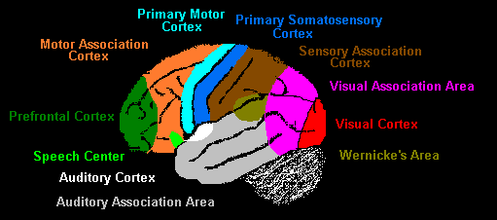

Slide 4
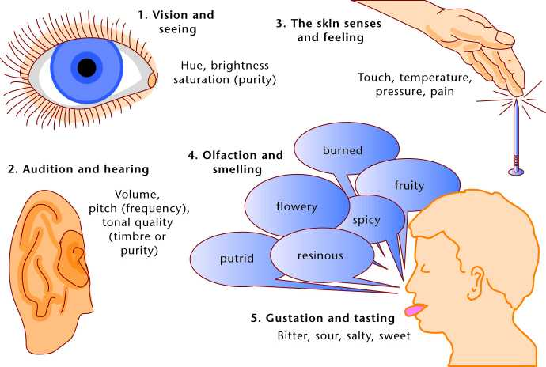
Brain performs classifications, predictions and associations

Slide 5
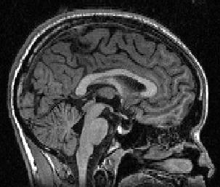
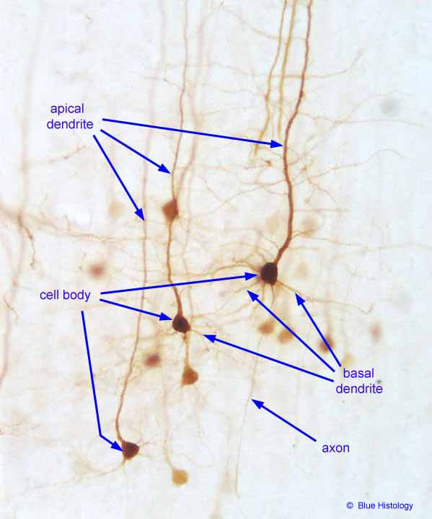
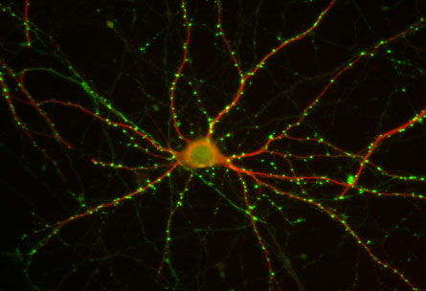
Huge connectivity: each neuron sends and receives 10⁴ of synapses (contacts)
Huge complexity
10¹¹ of neurons in the brain

Slide 6

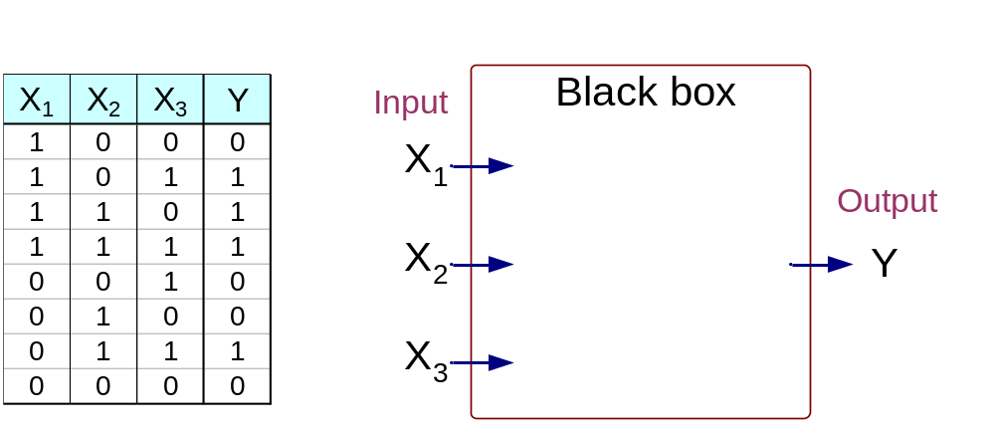
Output Y is 1 if at least two of the three inputs are equal to 1.

Slide 7
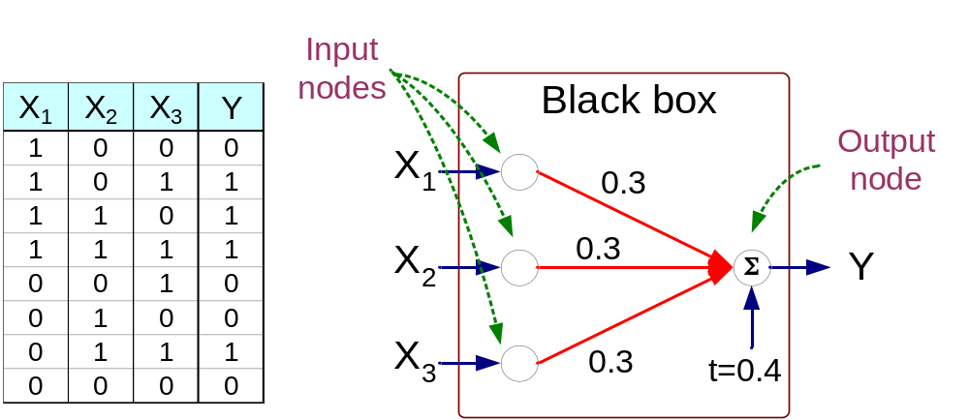
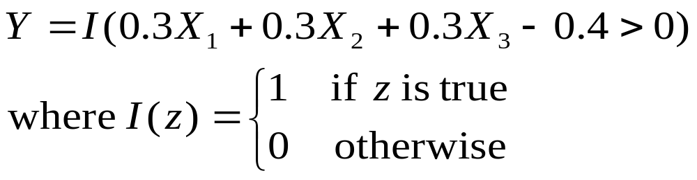

Slide 8

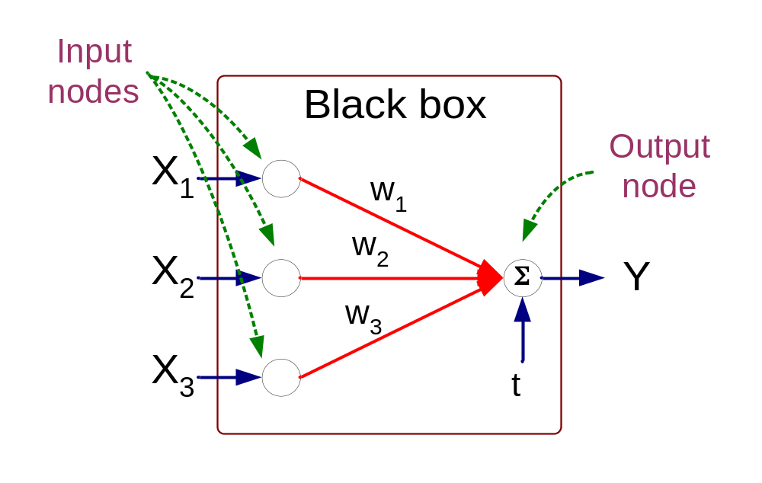
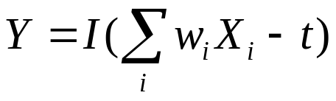
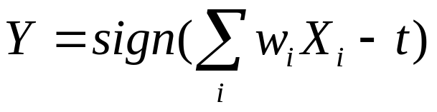
Model is an assembly of inter-connected nodes and weighted links
Output node sums up each of its input value according to the weights of its links
Compare output node against some threshold t
Perceptron Model
or

Slide 9

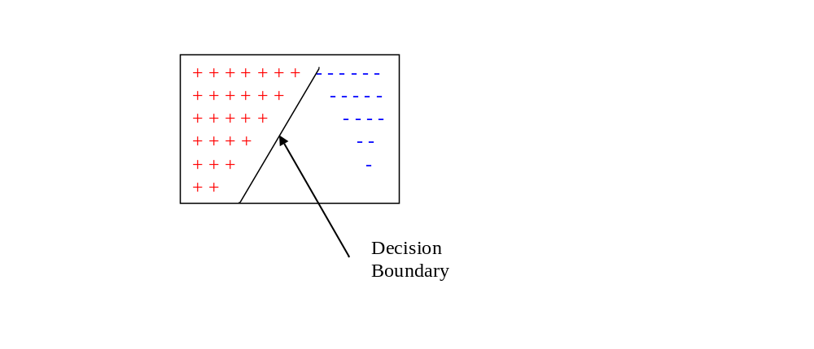
Simple perceptrons can be used to classify problems which are linearly separable
For such problems a single line can be drawn which separates the two classes with zero (or near zero) error

Slide 10


However simple perceptrons cannot solve non linear classification problems such as the XOR problem
These types of problems can only be solved by adding another layer (called the hidden layer) of neurons to the network

Slide 11

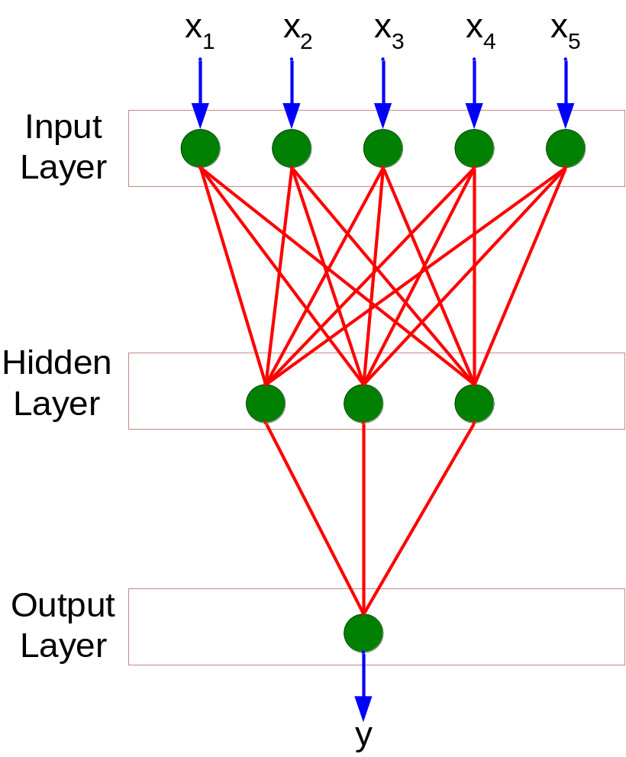
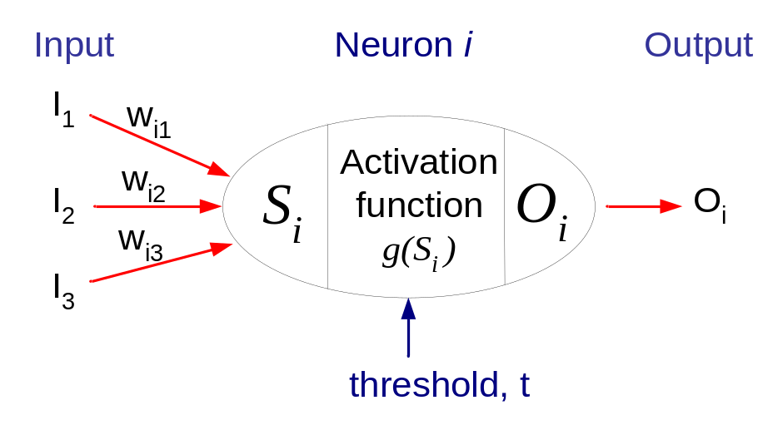
Training ANN means learning the weights of the neurons

Slide 12
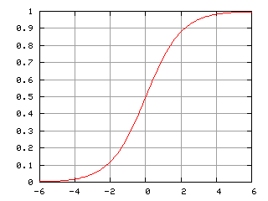
Just as with human neurons, the neurons in the hidden layer are activated only when the input they receive is above a certain threshold value
To model this situation the sigmoid function is commonly used as an activation function

Slide 13

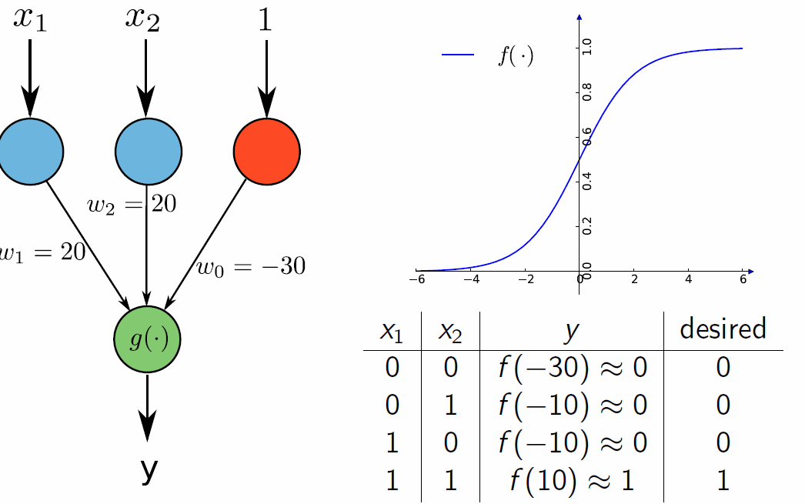

Slide 14

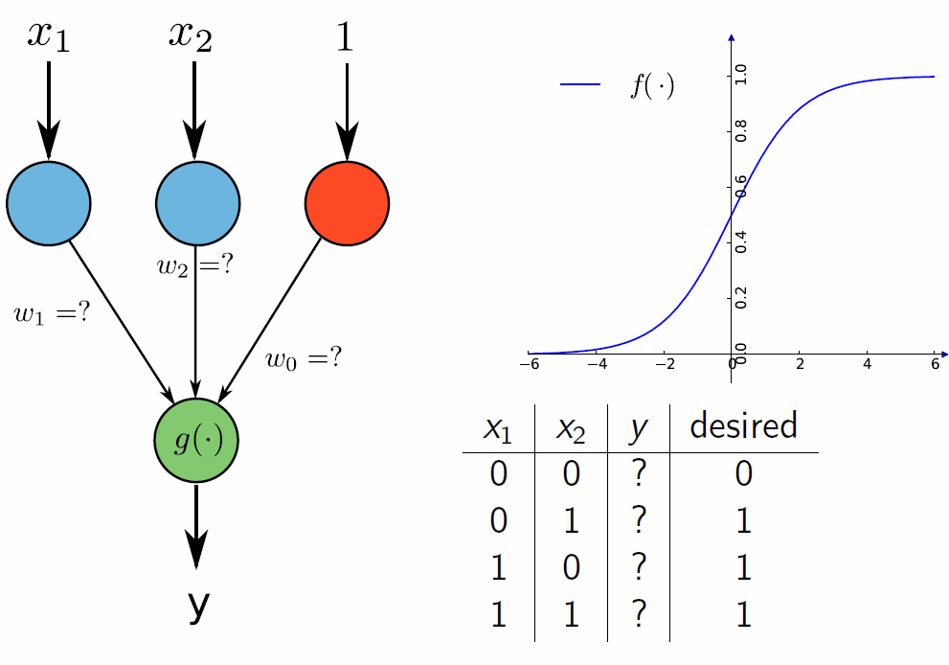

Slide 15

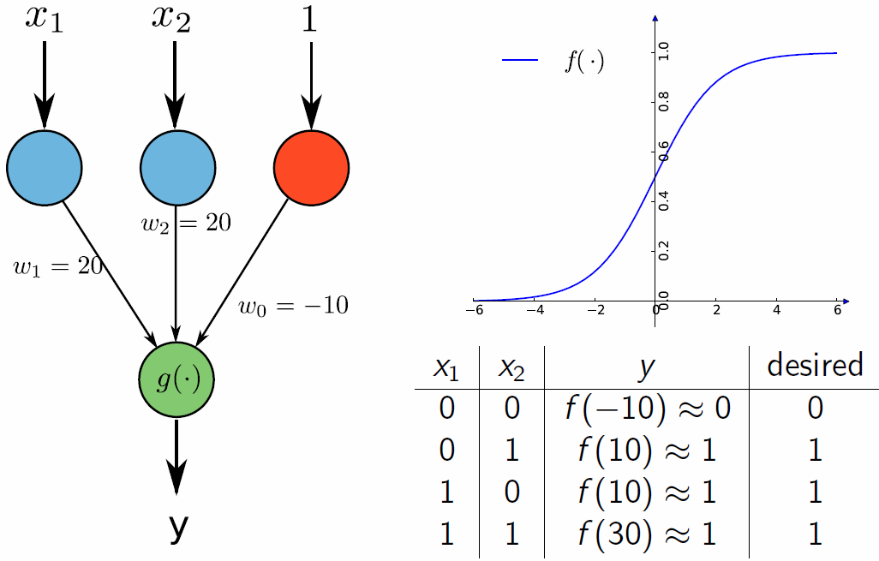

Slide 16
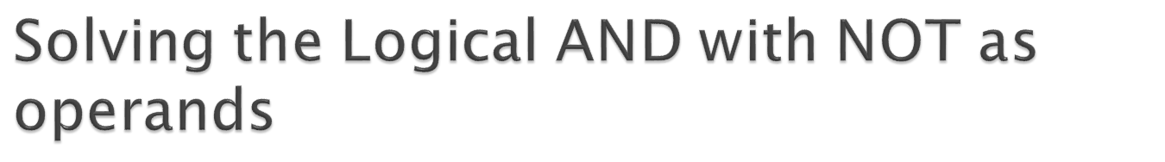
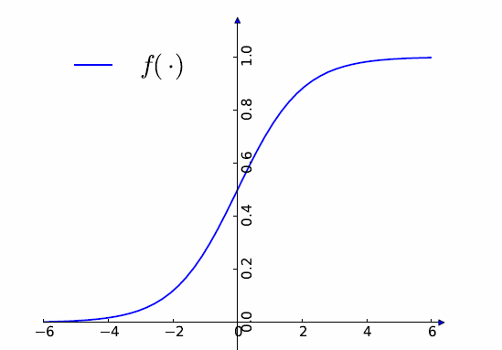
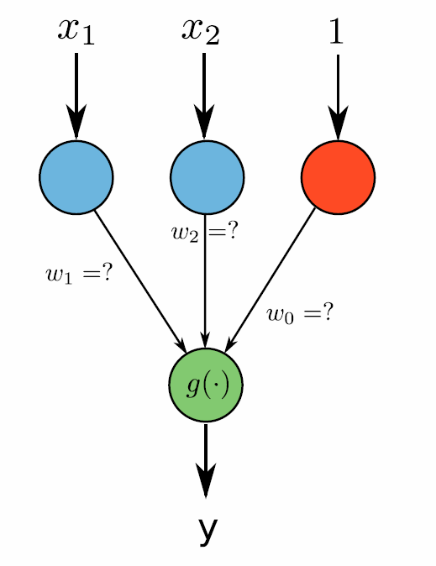
X₁ | X₂ | NOT X₁ | NOT X₂ | y | desired
0 | 0 | 1 | 1 | ? | 1
0 | 1 | 1 | 0 | ? | 0
1 | 0 | 0 | 1 | ? | 0
1 | 1 | 0 | 0 | ? | 0

Slide 17
The XNOR problem is more difficult than the logical AND problem.
It cannot be solved by a single neuron as it is a 2 stage process
(X1 XNOR X2) = Y1 OR Y2 where Y1=(X1 AND X2) and Y2=(NOT X1 AND NOT X2)
This can be seen from the following truth table
X1 | X2 | Y1 | Y2 | Y1 OR Y2 | X1 XNOR X2
0 | 0 | 0 | 1 | 1 | 1
0 | 1 | 0 | 0 | 0 | 0
1 | 0 | 0 | 0 | 0 | 0
1 | 1 | 1 | 0 | 1 | 1

Slide 18

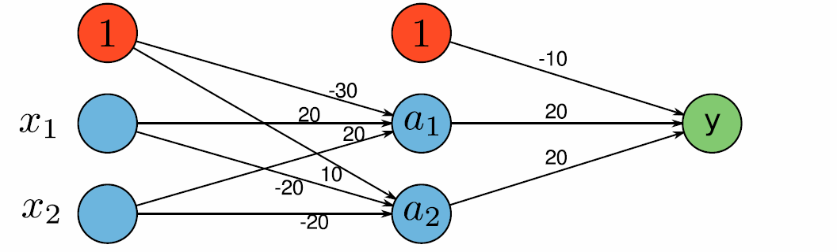
Thus we design a network where we first solve the two problems of finding Y1, Y2 in the first stage and then in the second stage we compute Y1 OR Y2.
Y1 and Y2 can be computed in parallel and so 2 neurons can be assigned to do the computation in the hidden (intermediate layer).

Slide 19

Initialize the weights (w₀, w₁, …, w_{k})
Compute the error at each output node (k), and the hidden node (j) connected to it.
Now adjust the weights w_{jk} such that
w_{jk}(new) = w_{jk}(current)+Δw_{jk}
where Δw_{jk}=rError(k)O_{j}
r = learning rate parameter (0<r<1)
Error(k) = the computed error at node k
O = output of node j

Slide 20

Thus it can be seen that the observed errors are used to adjust the weights so that the overall error is minimized
For example if the desired output at node k is 1 and the actual output is 1.2, then the error = (1-1.2)=-.2, so we need to decrease the weight of all incoming links into node k
The weight adjustment process is done iteratively until the error is below some specified threshold – this will involve scanning the data many times over

Slide 21

Learning rate – this determines the size of the “steps taken” in the weight adjustment process – larger steps means learning takes place quicker but accuracy may suffer
Number of epochs – the number of times that the training dataset is scanned – larger the value the more accurate the model (generally 100 or more)
The number of hidden neurons used – generally chosen as (attributes+classes)/2
Momentum – some implementations add a term called the momentum to the current weight – this is a small fraction of the update value from the previous iteration; the momentum makes the learning process smoother

Slide 22

Neural Nets work well with datasets containing a large amount of noise
Have consistently good accuracy rates across several domains
Can be used for both supervised (classification and numeric prediction) as well as unsupervised learning

Slide 23

Lacks the ability to explain their behaviour (unlike Decision Trees and Naïve Bayes)
In some cases, overtraining can cause over fitting – i.e. the NN has a good accuracy on training data but poor accuracy on the test data
With large datasets training time can be large – very much larger than the Decision Tree and Naïve Bayes methods

Slide 24

In general can be used for classification as well as for numeric prediction
For classification has been used for recognizing both printed and handwritten digits
For numeric prediction has been used for forecasting time series such as weather data (temperature, pressure, wind speed, etc), stock market prices, etc.
Neural Network handwritten recognition:
http://www.sund.de/netze/applets/BPN/bpn2/ochre.html
Neural Nets play Pong:
http://www.youtube.com/watch?v=LD6OgKEj5JE

